Slide 1
Modeling Income with Linear Mixed Effect Model
By Benjamin Stano

Slide 2
Research Focus
The Problems
What are the most important income-determining factors in America?
Quantify how these factors affect income?
The Solutions
Importance-Based Random Forest Feature Selection
Descriptive Linear Mixed Effect Modeling

Slide 3
Other Available Models
Focus on Linear Mixed Effect modeling in this project
Other possible models to use
Pareto distribution model works well to model income
Not well-supported with mixed effects
Random Forest Mixed Effect has higher overall accuracy
No insight into how features interact

Slide 4
Contents
Data Introduction
Feature Selection Method using Random Forest
Mixed Effect Modeling Results
Analysis and Conclusions

Slide 5
Part 1: Introducing the Data

Slide 6
General Social Survey Data
American social survey
Biannual since 1972
Broad range of topics, focus on work life
Each survey year with different feature set
Use 8 most recent years
Shared years data set: 407 Features, 24350 Respondents
Outcome: respondent's personal income
Scaled to 1986 inflation
Income scaled to 1986 inflation
Datasets 2000-2016 (8 years) : http://gss.norc.org/get-the-data/spss

Slide 7
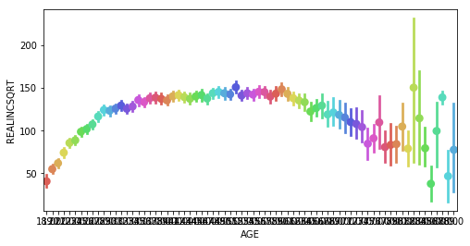
Age vs. Income
Respondent Age and Income
Age will be the control group for LME model
Age and Income are related
Correlation of 0.18
Relationship not linear
Square Root of Income
Age (18-81 years)

Slide 8
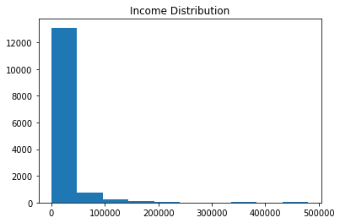
Income Distribution
Normal outcome good for health of linear model
9,000 (37.5%) respondents removed, no data
Income distribution far from normal
Number of Values
Income Value

Slide 9
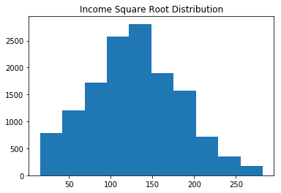
Making Income Normal
Removed 544 (2.1%) high earnerning outliers
max income $113k
Square Root of the Income
Much more normally distributed for analysis
Modeling will relate to square root of Income
Number of Values
Square Root Income Value

Slide 10
Feature Selection

Slide 11
Feature Selection Goals
Linear Mixed Effect (LME) models easily overburdened
406 total features to 4 total
Complex categorical data does not mix with linear model
Create binary dummy variables
PCA does not lend itself to descriptive modeling
Use Random Forest to determine feature importance, most important features

Slide 12
Feature Selection Process
Drop non-linear continuous features
Drop categorical features with too many non-answers
Fill in non-responses with average values
Keep all features with more than 10% correlation with outcome
Keep feature importance from Random Forest model
Using importance to drop multi-collinear features
Re-run random forest for final importances
Model most important features to check consistency

Slide 13
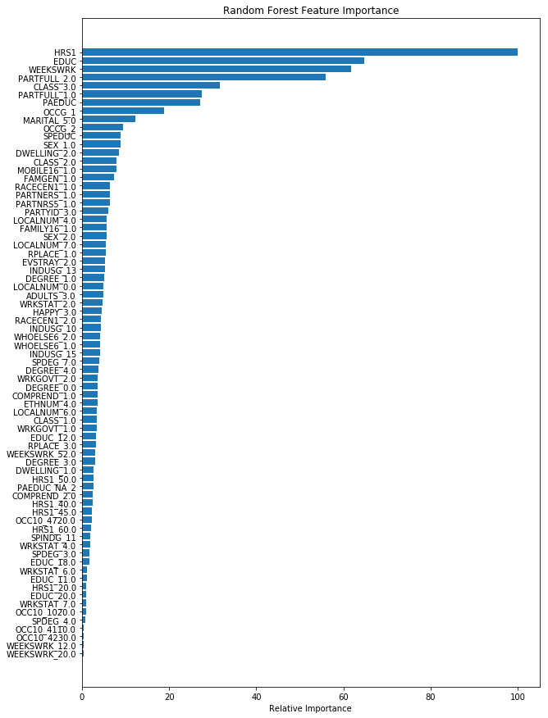
Feature Selection Results
4 Most Important Features:
Education Level (0-20)
Hours per Week (0-80)
Weeks per Year (0-52)
If the person works part-time

Slide 14
Feature Set Modeling Check Results
Feature Set is consistent enough to use LME on
Model Used | Random Forest |  | Gradient Boosted Trees |  | OLS Regression
Training Score | 0.623 |  | 0.489 |  | 0.370
Testing Score | 0.342 |  | 0.410 |  | 0.389
CV Score | 0.323 |  | 0.400 |  | 0.367

Slide 15
Part 3: Linear Mixed Effect Modeling

Slide 16
Linear Mixed Effect Modeling
Descriptive model for groups within a population
Use Respondent Age as group
Age has an ICC of 20%
Uses fixed and random effects
Fixed effects, trends the whole population follows
Random effect, trends group members follow
Must determine random effect configuration
Compare configurations with likelihood ratio test
4 features and the intercept can be random or fixed
31 different random effect configurations

Slide 17
LME Random Effect Configuration
A Linear model without mixed effects:
where a, b, c, and d are coefficients calculated by the model
But I am using and Linear Mixed Effect model
Best configuration was Random Intercept, Education, and Part-time
General Linear Equation With Random Effects:
intercept, education slope, and part-time slope change with age

Slide 18
LME Assumptions
LME models require 5 assumptions to be met:
Dependency between group members
Age has an ICC of 20%
Features are linearly related
Residuals are normally distributed
Residuals have constant variance
Residuals are independent (Homoscedastic)

Slide 19
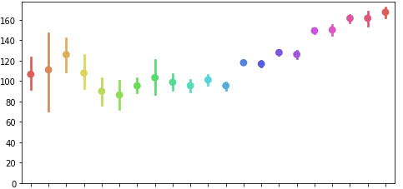
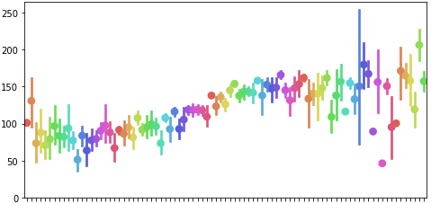
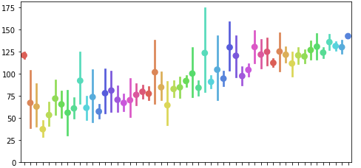
Linearity of Continuous Features
All continuous features have a near linear relationship with the square root of the income
Square Root of Income
Income vs. Education Level
Years of Education (0-20 years)
Income vs. Hours Worked
Square Root of Income
Square Root of Income
Income vs. Weeks Worked
Average Hours Worked per Week (0-80+ hours)
Average Weeks Worked per Year (0-52 weeks)

Slide 20
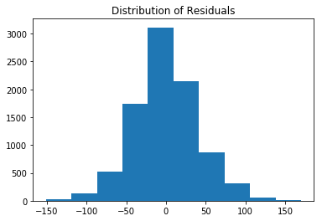
Checking Model Residuals
Check error distribution among income values
Error is normally distributed
Next Slide, look at error distribution among features
Number of Values
Predicted Income Value

Slide 21
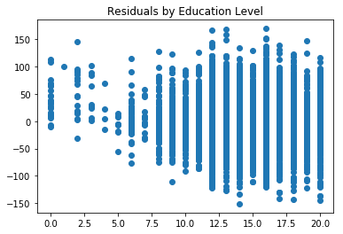
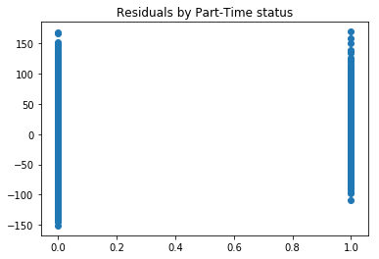
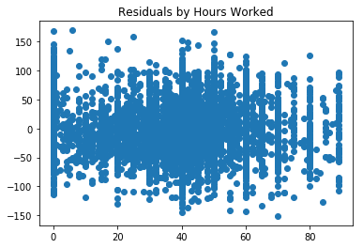
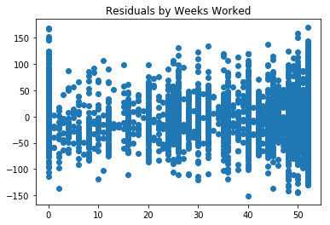
Checking Model Residuals II

Slide 22
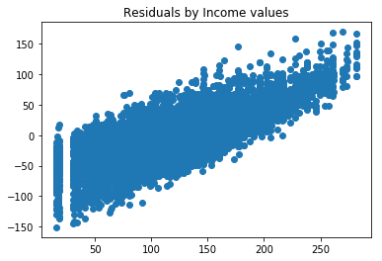
Checking Model Residuals III
Finally, test error among all values of income
Error is not homoscedastic
Focus for future model improvement
Predicted Income Value
Real Income Value

Slide 23
Results and Conclusions

Slide 24
Fixed Effect Model Results
Feature | Coefficient | Standard Error
Intercept | 16.118 | 2.578
Education | 5.068 | 0.223
Hours | 0.540 | 0.025
Weeks | 0.624 | 0.030
Part-Time | -40.326 | 1.734
Income limit $113k, set to 1986 inflation
Square Root Income:
Base of 16.118
Increases by 5.068 for each additional year of formal education
Increases by 0.540 for each additional hour worked per week
Increases by 0.624 for each additional week worked per year
Goes down by -40.326 if part-time job

Slide 25



Mixed Effect Model Results
Feature | Coefficient | Group Variance
Intercept | 16.118 | 31.100
Education | 5.068 | 1.462
Hours | 0.540 | n/a
Weeks | 0.624 | n/a
Part-Time | -40.326 | 78.848
Intercept, Education and Part-Time fluctuate the most between different ages
Coefficients with random effects represent the average among all ages
Education low variance
Part-Time and the Intercept both have extremely high variance
where has an average value of and have an average value of 5.159 and -40.764 respectively

Slide 26
The Part-Time Difference
Average income of 2 high school graduates, working 40 hour weeks and 51 week years, where one works part-time and the other does not:
Same education and work time, but non-part time makes $17,000, part-time $8,000
Part-time worker makes less than half

Slide 27
Summary Takeaways
4 most important income factors: education, hours, weeks, part-time
Factor affect have been quantified
Education, working part time, base income effects differ more between age than hours per week and weeks per year effects
Being a part-time worker is extremely detrimental to income
Model can be improved, Fixing heteroscedasticity
Overpredicts low income, underpredicts high income

Slide 28
References
Dataset
http://gss.norc.org/
http://gss.norc.org/documents/codebook
Other Resources
ci.columbia.edu/ci/premba_test/c0331/s7/s7_5.html
stat.ncsu.edu/people/bloomfield/courses/st732/02-21.pdf
stats.stackexchange.com/questions/267325
stats.stackexchange.com/questions/141619
https://statisticalmodeling.wordpress.com/2011/06/23/the-pareto-distribution/

Slide 29
Appendix

Slide 30
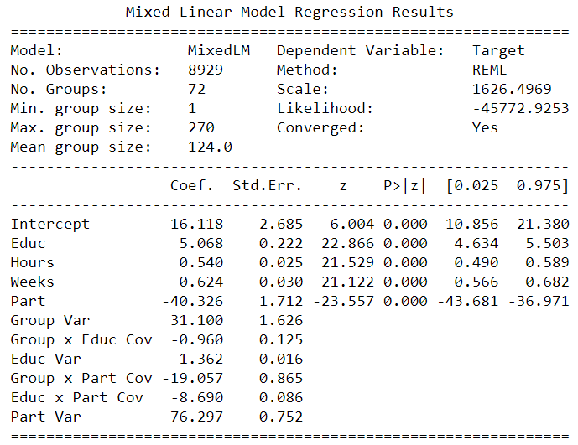
LME Raw Results

Slide 31
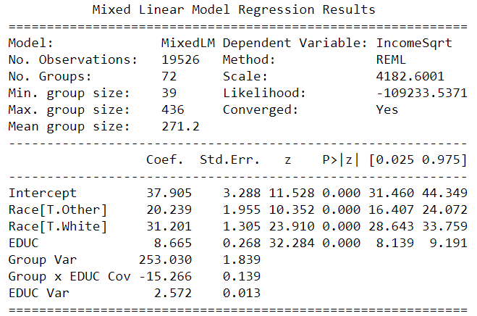
Income, Education, and Race LME
Predicted Income with Education and Race, when controlling for Age
Race used: white, black, other
Black became intercept

Slide 32
Income, Education, and Race Table
Years of Education | Black | White | Other
5 | $6,598 | $12,641 | $10,296
6 | $8,081 | $14,664 | $12,129
7 | $9,714 | $16,838 | $14,113
8 | $11,497 | $19,162 | $16,247
9 | $13,430 | $21,636 | $18,531
12 | $20,131 | $29,959 | $26,284
16 | $31,168 | $43,158 | $38,724
20 | $44,608 | $58,761 | $53,566

Slide 33
Questions?

